Slide 1
NP-Completeness
Presentation for use with the textbook, Algorithm Design and Applications, by M. T. Goodrich and R. Tamassia, Wiley, 2015
x
x
x
x
x
x
x
x
1
1
2
2
3
3
4
4
12
22
32
11
13
21
23
31
33

Slide 2
Running Time Revisited
“Efficient” means There is a polynomial p(n) time algorithm, O(n^{k}).
We can redefine the input size, n as:
the number of bits in a nonunary encoding of the input
All the polynomial-time algorithms studied so far in this course run in polynomial time using this definition of input size.
Exception: any pseudo-polynomial time algorithm
Travelling Salesperson Problem (TSP)
Is there a cycle (or tour) in weighted graph G that visits all vertices of G (possibly more than once) with a total weigh of at most k?
849
PVD
There are many other versions
of the TSP, some assume:
G is directed
Ask for minimum total
Visit once,
Start and end the same.
1843
ORD
SFO
142
802
LGA
337
1743
HNL
1387
2555
1099
LAX
1233
DFW
1120
MIA

Slide 3
Dealing with Hard Problems
What to do when we find a problem that looks hard…
I couldn’t find a polynomial-time algorithm;
I guess I’m too dumb.
(cartoon inspired by [Garey-Johnson, 79])

Slide 4
Dealing with Hard Problems
Sometimes we can prove a strong lower bound… (but not usually)
I couldn’t find a polynomial-time algorithm,
because no such algorithm exists!
(cartoon inspired by [Garey-Johnson, 79])

Slide 5
Dealing with Hard Problems
NP-completeness let’s us show collectively that a problem is hard.
I couldn’t find a polynomial-time algorithm,
but neither could all these other smart people.
(cartoon inspired by [Garey-Johnson, 79])

Slide 6
Polynomial-Time Decision Problems
To simplify the notion of “hardness,” we will focus on the following criteria:
It’s a Decision problems:
Output is 1 or 0 (“yes” or “no”)
Examples:
Does a given graph G have an Euler tour?
Does a text T contain a pattern P?
Does an instance of 0/1 Knapsack have a solution with benefit at least K?
Does a graph G have an MST with weight at most K?
Polynomial-time as the cut-off for efficiency

Slide 7
Problems and Languages
A language L is a set of strings defined over some alphabet Σ
Every decision algorithm A defines a language L
L is the set consisting of every string x such that A outputs “yes” on input x.
We say “A accepts x” in this case
Example:
If A determines whether or not a given graph G has an Euler tour, then the language L for A is all graphs with Euler tours.
We say “A rejects x” if A outputs “no” on input x

Slide 8
The Complexity Class P
A Complexity Class is defined as a collection of languages
P is the complexity class consisting of all languages that are accepted by polynomial-time algorithms
For each language L in P there is a polynomial-time decision algorithm A for L.
If n=|x|, for x in L, then A runs in p(n) time on input x.
The function p(n) is some polynomial.

Slide 9
The Complexity Class NP
We say that an algorithm is non-deterministic if it uses an additional operation:
Choose(b): where it chooses a bit b (0 or 1) nondeterministically
Can be used to choose an entire string y (with |y| choices)
We say that a non-deterministic algorithm A accepts a string x if there exists some sequence of choose operations that causes A to output “yes” on input x.
NP is the complexity class consisting of all languages accepted by polynomial-time non-deterministic algorithms.

Slide 10
NP Example 1
Problem: Decide if a graph has an MST of weight K
Algorithm:
Non-deterministically choose a set T of n-1 edges
Test that T forms a spanning tree
Test that T has weight at most K
Analysis: Choosing n-1 edges takes O(n). Testing T by DFS to see it has no cycle (all edges are discovery edges) takes O(n+m) =O(n+n-1)=O(n). So this algorithm runs in polynomial time.

Slide 11
The Complexity Class NP Alternate Definition
We say that an algorithm B verifies the acceptance of a language L if and only if, for any x in L, there exists a deterministic certificate y such that B outputs “yes” on input (x,y).
We say B outputs “yes”, in polynomial time p(n), on input z=x+y, the concatenation of x and y. So |y| ≤ p(n)
NP is the complexity class consisting of all languages verified by polynomial-time algorithms.
We know: P is a subset of NP.
Major open question: P=NP?
Most researchers believe that P and NP are different.

Slide 12
NP Example 2
Problem: Decide if a graph has an MST of weight K
Verification Algorithm:
Use as a certificate, y, a set T of n-1 edges
Test that T forms a spanning tree
Test that T has weight at most K
Analysis: Verification takes O(n) time, so this algorithm runs in polynomial time.

Slide 13
Equivalence of the Two Definitions
Suppose A is a non-deterministic algorithm
Let y be a certificate consisting of all the outcomes of the choose steps that A uses
We can create a verification algorithm B that uses y instead of A’s choose steps
If A accepts on x, then there is a certificate y that allows us to verify x+y
If A runs in polynomial-time, so does this verification algorithm
Suppose B is a verification algorithm
Construct a nondeterministic Algorithm A that takes x and
call the choose method to assign the value of each bit in y.
Run B on y
If B runs in polynomial-time, so does this non-deterministic algorithm

Slide 14
TSP is in NP
TSP: Given a set of N cities and distances between any two cities, find a tour with minimum total cost.
TSP Equivalent Decision Problem: Given an integer k, is there a cycle that visits each city exactly once, returning to the start city with total distance of at most k?
Proof:
We define a non-deterministic algorithm that accepts instances of TSP
Number the cities 1 to N
Call choose method to determine a sequence S of N+1 numbers from 1 to N
Check that each number appears exactly once in S (e.g. by sorting S) except the first and last numbers in S.
Check that the sequence S defines a cycle and its total distance is at most k.
So if there is such tour S, then our algorithm outputs “yes” and it has found a tour.
Since this algorithm runs in polynomial time, TSP is in NP.
Note: You may assume G is complete graph or missing edges have infinite distance.

Slide 15
CIRCUIT-SAT
A Boolean Circuit is a directed graph, where each node (logic node) is a Boolean function AND, OR, or NOT.
CIRCUIT-SAT problem is to determine if there is an assignment (called satisfying assignment) of 0’s and 1’s to a circuit’s inputs so that the circuit outputs 1.

Slide 16
CIRCUIT-SAT is in NP
We need to construct nondeterministic algorithm for accepting CIRCUIT-SAT in polynomial time
Use choose method to “guess” a set of inputs and the outputs of each logic gate.
Then test each gate’s I/O for correctness and final output.
If its is a satisfying assignment, output “yes”.
This algorithm runs in Polynomial time.

Slide 17
NP-Completeness
A problem (language) L is NP-hard if every problem in NP can be reduced to L in polynomial time.
That is, for each language M in NP, we can take an input x for M, transform it in polynomial time to an input x’ for L such that x is in M if and only if x’ is in L.
L is NP-complete if it’s in NP and is NP-hard.
NP
poly-time
L

Slide 18
Cook-Levin Theorem
CIRCUIT-SAT is NP-complete.
We already showed it is in NP.
To prove it is NP-hard, we have to show that every language in NP can be reduced to it.
Let M be in NP, and let x be an input for M.
Let y be a certificate that allows us to verify membership in M in polynomial time, p(n), by some algorithm D.
Let S be a circuit of size at most O(p(n)²) that simulates a computer (details omitted…)
NP
M
poly-time
CIRCUIT-SAT

Slide 19
Cook-Levin Proof
We can build a circuit that simulates the verification of x’s membership in M using y.
Let W be the working storage for D (including registers, such as program counter); let D be given in RAM “machine code.”
Simulate p(n) steps of D by replicating circuit S for each step of D. Only input: y.
Circuit is satisfiable if and only if x is accepted by D with some certificate y
Total size is still polynomial: O(p(n)³).
D
D
D
< p(n)
W
W
W
cells
S
S
S
Output
0/1
from D
Inputs
y
y
y
n
x
x
x
p(n)
steps

Slide 20
Some Thoughts about P and NP
NP
NP-complete
problems live here
P
CIRCUIT-SAT
Belief: P is a proper subset of NP.
Implication: the NP-complete problems are the hardest in NP.
Why: Because if we could solve an NP-complete problem in polynomial time, we could solve every problem in NP in polynomial time.
That is, if an NP-complete problem is solvable in polynomial time, then P=NP.
Since so many people have attempted without success to find polynomial-time solutions to NP-complete problems, showing your problem is NP-complete is equivalent to showing that a lot of smart people have worked on your problem and found no polynomial-time algorithm.

Slide 21
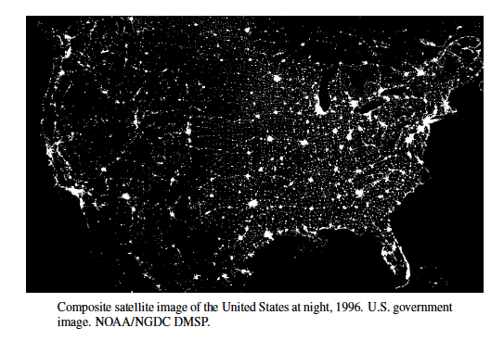
NP-Completeness Proofs
Presentation for use with the textbook, Algorithm Design and Applications, by M. T. Goodrich and R. Tamassia, Wiley, 2015

Slide 22
Problem Reduction
A language M is polynomial-time reducible to a language L if an instance x for M can be transformed in polynomial time to an instance x’ for L such that x is in M if and only if x’ is in L.
Denote this by M→L.
A problem (language) L is NP-hard if every problem in NP is polynomial-time reducible to L.
A problem (language) is NP-complete if it is in NP and it is NP-hard.
CIRCUIT-SAT is NP-complete:
CIRCUIT-SAT is in NP
For every M in NP, M → CIRCUIT-SAT.
Inputs:
0
1
0
1
1
1
0
1
Output:
1
1
0
0
1

Slide 23
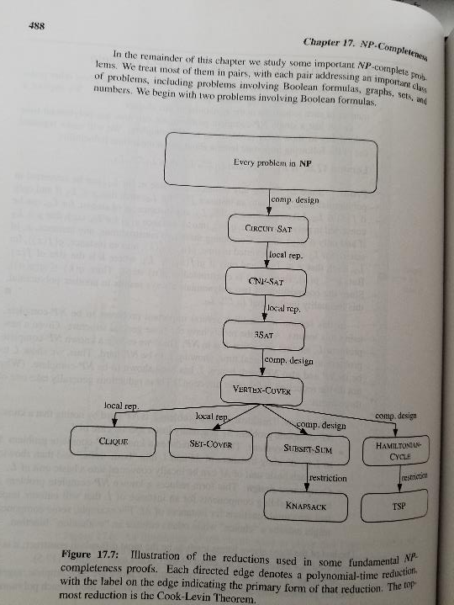

Slide 24
Transitivity of Reducibility
If A → B and B → C, then A → C.
An input x for A can be converted to x’ for B, such that x is in A if and only if x’ is in B. Likewise, for B to C.
Convert x’ into x’’ for C such that x’ is in B iff x’’ is in C.
Hence, if x is in A, x’ is in B, and x’’ is in C.
Likewise, if x’’ is in C, x’ is in B, and x is in A.
Thus, A → C, since polynomials are closed under composition.
Types of reductions:
Restriction: Show A → B by noting that B is just a special case of A
Local replacement: Show A → B by dividing an input to A into components and show how each component can be converted to a component for B.
Component design: Show A → B by building special components for an input of B that enforce properties needed for A, such as “choice” or “evaluate.”

Slide 25
CNF-SAT is in NP
A Boolean formula is a formula where the variables and operations are Boolean (0/1):
(a+b+¬d+e)(¬a+¬c)(¬b+c+d+e)(a+¬c+¬e)
OR: +, AND: (times), NOT: ¬, Implies, and IFF.
A Boolean formula is in Conjunctive Normal Form (CNF) if it formed by AND clauses of OR and negation, called literals
Like the example above
SAT: Given a Boolean formula S, is S satisfiable, that is, can we assign 0’s and 1’s to the variables so that S is 1 (“true”)?
Easy to see that CNF-SAT is in NP:
Non-deterministically choose an assignment of 0’s and 1’s to the variables and then evaluate each clause. If they are all 1 (“true”), then the formula is satisfiable.

Slide 26
CNF-SAT is NP-complete
Reduce CIRCUIT-SAT to SAT.
Given a Boolean circuit, make a variable for every input and gate.
Create a sub-formula for each gate, characterizing its effect. Form the formula as the output variable AND-ed with all these sub-formulas:
Example: m((a+b)↔e)(c↔¬f)(d↔¬g)(e↔¬h)(ef↔i)…
Inputs:
a
e
h
b
The formula is satisfiable
if and only if the
Boolean circuit
is satisfiable.
i
k
c
f
Output:
m
g
j
n
d

Slide 27

3SAT is NP-complete
The 2SAT can be solved in polynomial time (see Exercises C-17.6 and C-17.7).
So we cannot conclude the restricted forms of CNF-SAT are NP-complete. But we show 3SAT is NP-complete.
The 3SAT problem is a Boolean formula in CNF, with each clause having three literals. Example:
(a+b+¬d)(¬a+¬c+e)(¬b+d+e)(a+¬c+¬e)
We can transform every clause of SAT to be a 3SAT clause by local replacement of every clause to have three literals. ( See Page 491)
Converting one term into product of four 3-terms
Converting two terms into product of two 3-terms
Converting three terms, no change
Converting k terms, k>3, into k 3-terms
Converting one term into product of four 3-terms

Slide 28
Vertex Cover
A vertex cover of graph G=(V,E) is a subset W of V, such that, for every edge (a,b) in E, a is in W or b is in W.
VERTEX-COVER: Given a graph G and an integer K, does G have a vertex cover of size at most K?
VERTEX-COVER is in NP: Non-deterministically choose a subset W of size K and check that every edge is covered by W.

Slide 29
Vertex-Cover is NP-complete
Reduce 3SAT to VERTEX-COVER.
Let S be a Boolean formula in CNF with each clause having 3 literals.
We construct a graph G and an integer k such that G has a vertex cover if and only if S is satisfiable
For each variable x, create a node for x and ¬x, and connect these two:
“Truth Setting” component: vertex cover must include one of the two vertices.
For each clause (a+b+c), create a triangle and connect these three nodes.
“Satisfaction Setting” Comp:
vertex cover must Include two
of the Three vertices
x
¬x
a
c
b

Slide 30
Vertex-Cover is NP-complete
Completing the construction
Connect each literal in a clause triangle to its copy in a variable pair.
E.g., a clause (x+y+z)
Let n=# of variables
Let m=# of clauses
Set K=n+2m
x
¬x
y
¬y
z
¬z
a
c
b

Slide 31
Vertex-Cover is NP-complete
Example: S=(a+b+c)(¬a+b+¬c)(¬b+¬c+¬d)
Graph has vertex cover of size K=4+6=10 if and only if S is satisfiable.
a
¬a
b
¬b
c
¬c
d
¬d
12
22
32
11
13
21
23
31
33

Slide 32
Clique
A clique of a graph G=(V,E) is a subgraph C that is fully-connected (every pair in C has an edge).
CLIQUE: Given a graph G and an integer K, is there a clique in G of size at least K?
CLIQUE is in NP: non-deterministically choose a subset C of size K and check that every pair in C has an edge in G.
This graph has
a clique of size 5

Slide 33
CLIQUE is NP-Complete
Reduction from VERTEX-COVER.
We construct the complement graph G’, which has the same vertex set as G, but has the edge (u,v) if and only if (u, v) is not in G
A graph G has a vertex cover of size K if and only if it’s complement has a clique of size n-K.
G
G’

Slide 34
Some Other NP-Complete Problems
SET-COVER: Given a collection of m sets, are there K of these sets whose union is the same as the whole collection of m sets?
NP-complete by reduction from VERTEX-COVER
SUBSET-SUM: Given a set of integers and a distinguished integer K, is there a subset of the integers that sums to K?
NP-complete by reduction from VERTEX-COVER

Slide 35
Some Other NP-Complete Problems
0/1 Knapsack: Given a collection of items with weights and benefits, is there a subset of weight at most W and benefit at least K?
NP-complete by reduction from SUBSET-SUM
Hamiltonian-Cycle: Given a graph G, is there a cycle in G that visits each vertex exactly once?
NP-complete by reduction from VERTEX-COVER
Traveling Salesperson Tour: Given a complete weighted graph G, is there a cycle that visits each vertex and has total cost at most K?
NP-complete by reduction from Hamiltonian-Cycle.

